Slide 1

Ad_Hoc Insights Consumer Goods
Presented By
Md Arshad Hussain

Slide 2
Objectives 🎯
AtliQ Hardwares (an imaginary enterprise) stands as a prominent computer hardware manufacturer in India, with notable global outreach.
Despite the growth, the leadership recognized a lack of timely insights for making smart and strategic data-driven decisions.
A decision was made to scale the analytics team by hiring new junior data analysts.
To identify suitable candidates, Tony Sharma, the Data Analytics Head, proposed a SQL-based assessment focusing on both technical abilities and interpersonal skills.
The assessment aims to generate actionable insights for 10 business-related ad hoc queries.

Slide 3
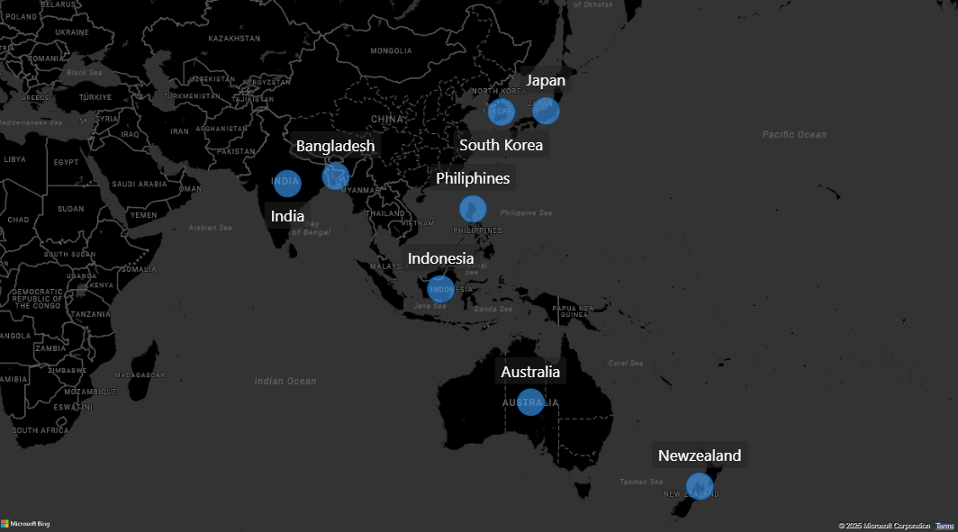
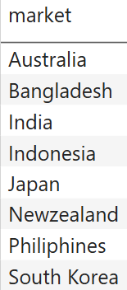
Q1. Provide the list of markets in which customer "Atliq Exclusive" operates its business in the APAC region.

Slide 4
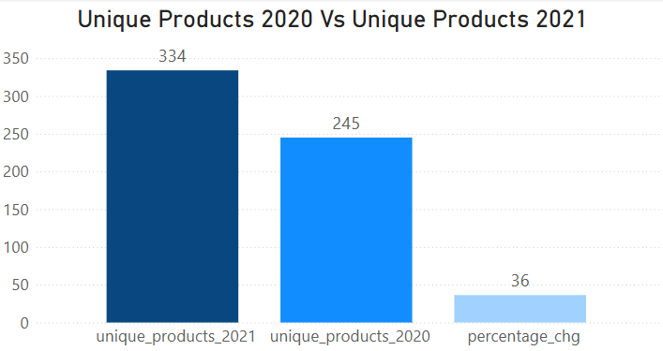

Q2. What is the percentage of unique product increase in 2021 vs. 2020? The final output contains these fields unique_products_2020 ,
unique_products_2021,
percentage_chg

Slide 5
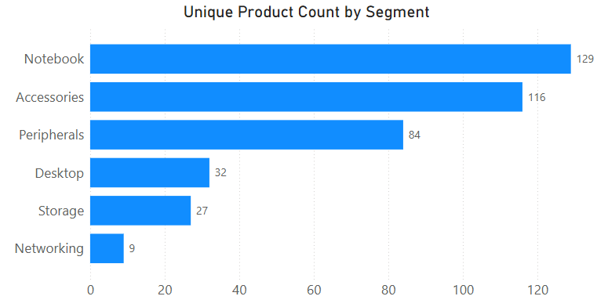
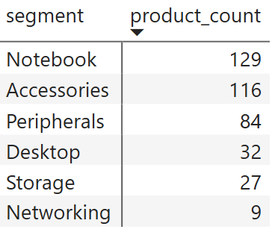
Q3.Provide a report with all the unique product counts for each segment and sort them in descending order of product counts. The final output contains 2 fields- segment, product_count

Slide 6
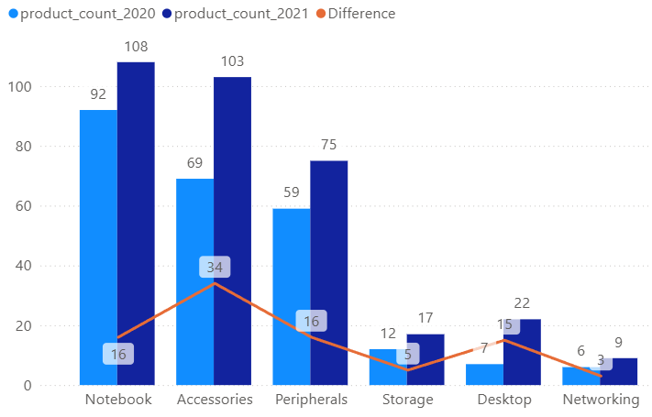
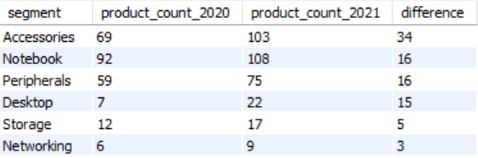
Q4. Follow-up: Which segment had the most increase in unique products in 2021 vs 2020? The final output contains these fields – segment, product_count_2020
product_count_2021 difference
Unique product difference per segment from 2020 to 2021

Slide 7
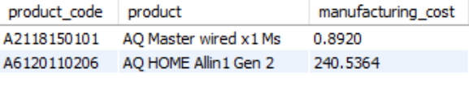
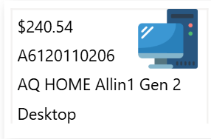
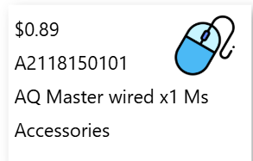
5. Get the products that have the highest and lowest manufacturing costs. The final output should contain these fields--product_code, product, manufacturing_cost
Products having the highest and lowest manufacturing costs

Slide 8
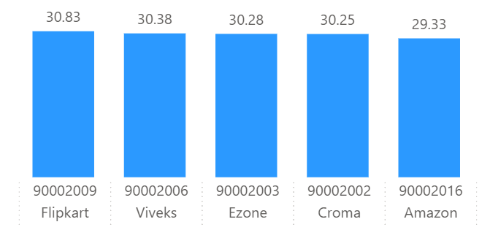
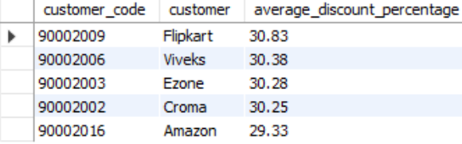
6. Generate a report which contains the top 5 customers who received an average high pre_invoice_discount_pct for the fiscal year 2021 and in the Indian market. The final output contains these fields, customer_code customer average_discount_percentage
Top 5 Indian customers with highest average discount percentage for FY 2021

Slide 9
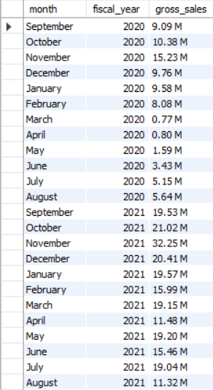
7. Get the complete report of the Gross sales amount for the customer “Atliq Exclusive” for each month . This analysis helps to get an idea of low and high-performing months and take strategic decisions. The final report contains these columns: Month, Year, Gross sales Amount
Gross Sales in FY 2020 79.5M
Gross Sales in FY 2020 224.42M

Slide 10
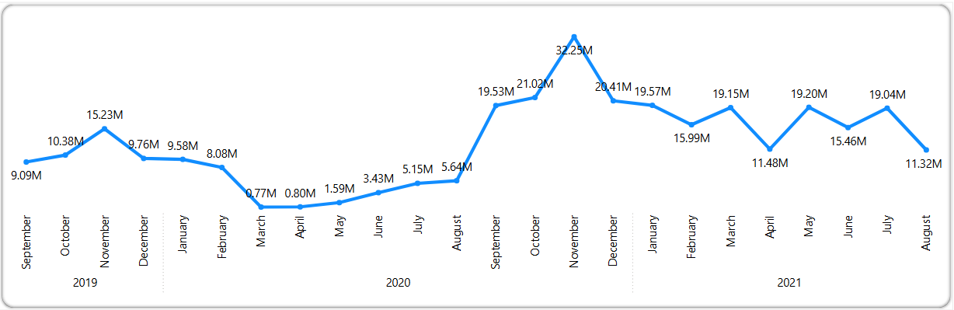
Gross sales amount report for Atliq Exclusive by month
Highest Gross Sales 32.25M
Lowest Gross Sales 0.77M

Slide 11
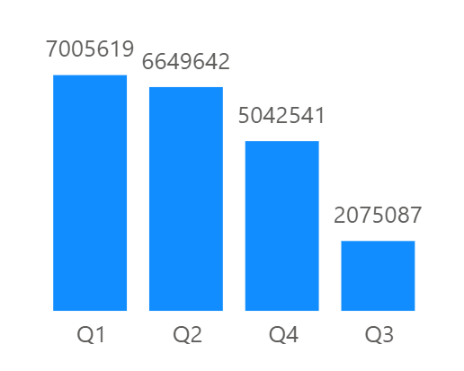
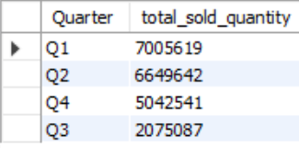
8. In which quarter of 2020, got the maximum total_sold_quantity? The final output contains these fields sorted by the total_sold_quantity
Quarter
total_sold_quantity
Total sold quantity in FY 2020 by Quarter

Slide 12
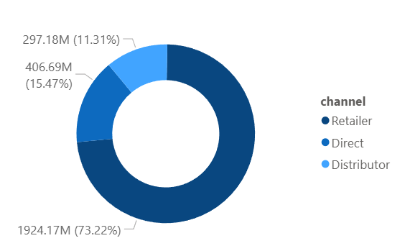
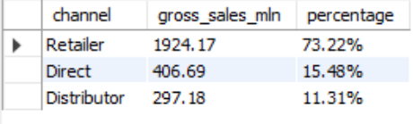
9. Which channel helped to bring more gross sales in the fiscal year 2021 and the percentage of contribution? The final output contains these fields,
Channel, gross_sales_mln, percentage
Gross sales and contribution percentages by Channel for FY 2021

Slide 13
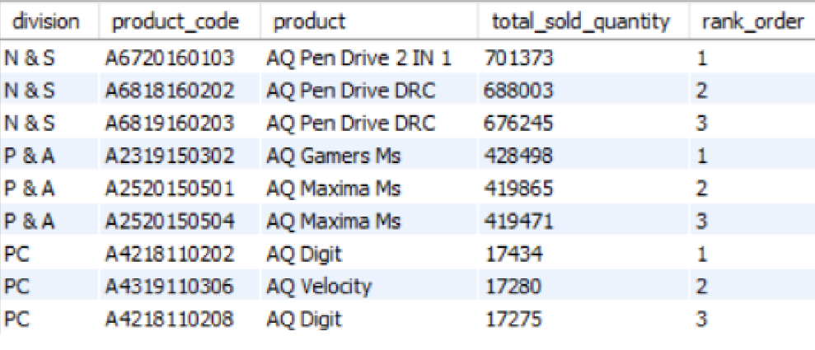
10. Get the Top 3 products in each division that have a high total_sold_quantity in the fiscal_year 2021? The final output contains these fields,
division, product_code, product, total_sold_quantity, rank_order

Slide 14
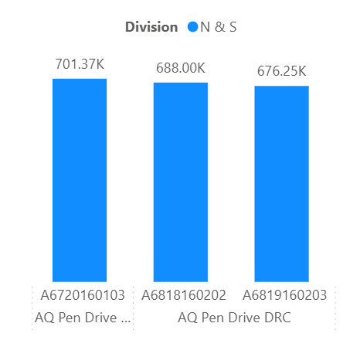
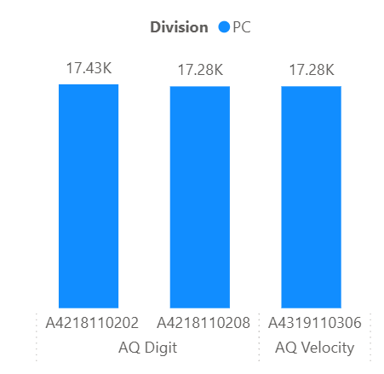
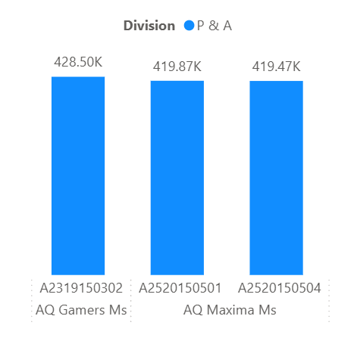
Top 3 highest-selling products by Division in the FY 2021

